Slide 1
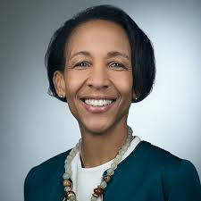
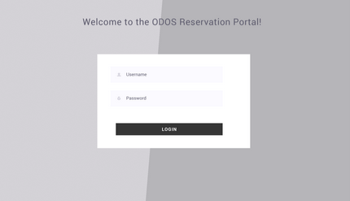
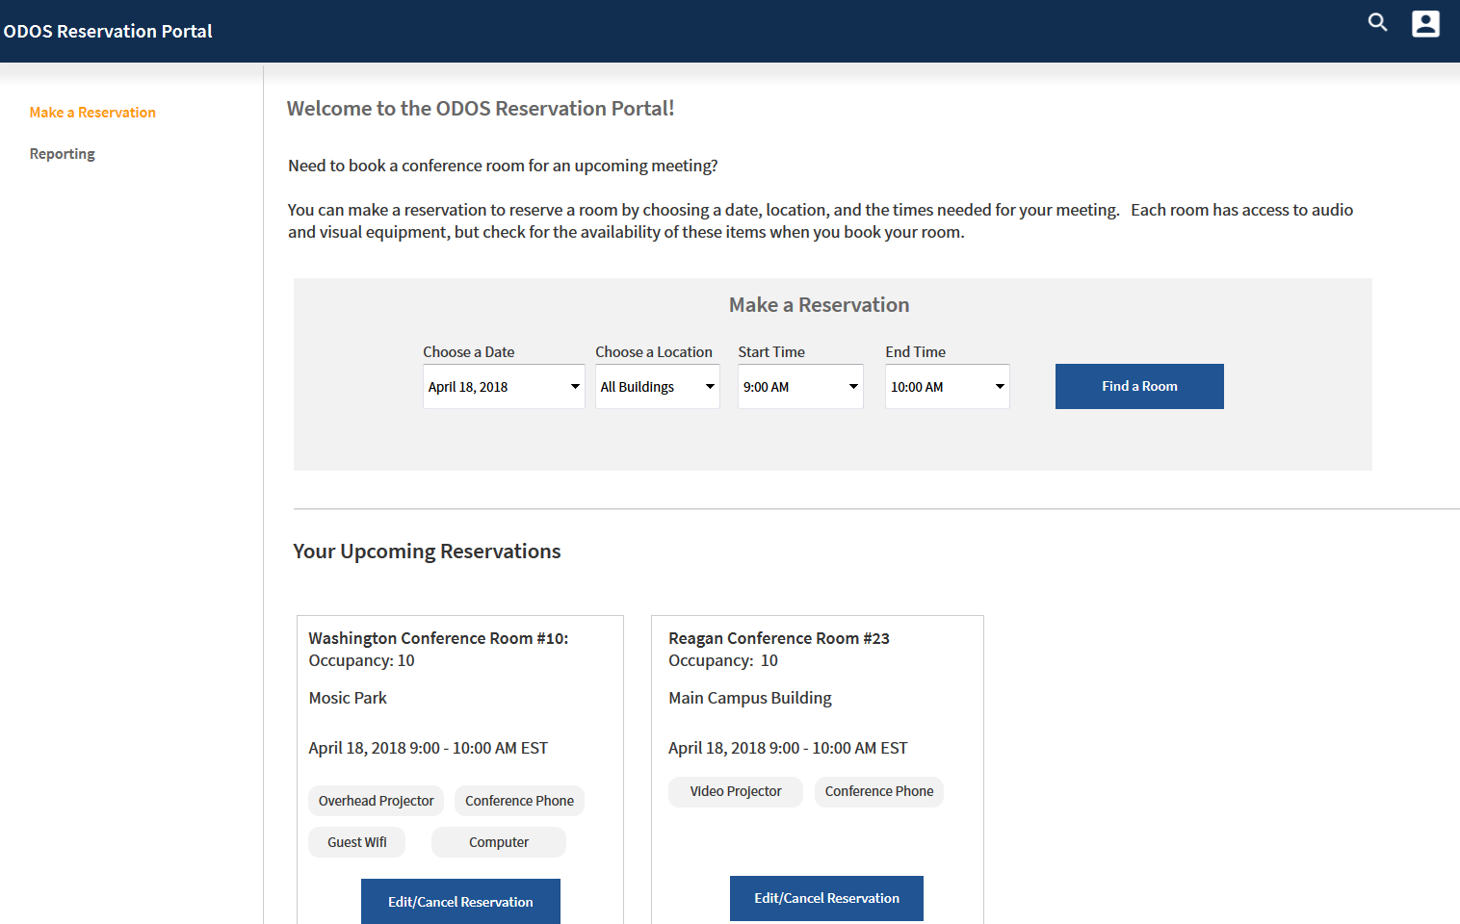
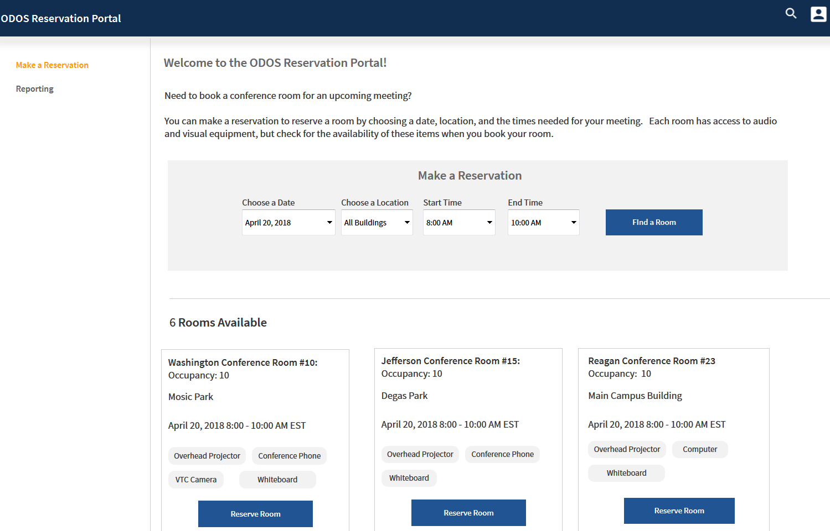
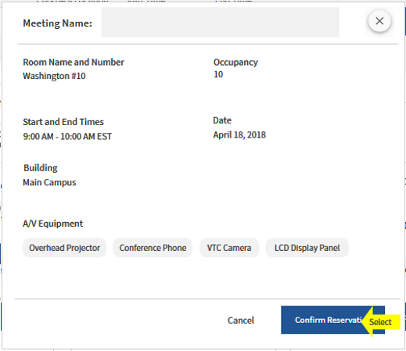
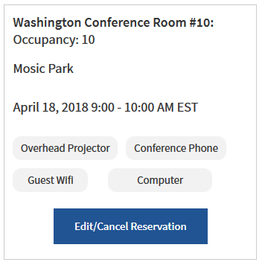
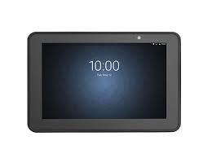
ODOS Reservation Portal: Persona > Requester
As a Requester, the display panel outside the conference room shall present/display conferences scheduled for that room and day in the format of “0000-0000 Conference Title Last Name”
As a Requester, I shall have information about the conference room presented during the reservation process: building, room number, and available A/V Equipment.
As a Requester, I shall be presented a graceful message if I book two conference rooms at the same time, and I book a conference room longer than 3 hours.
Requester
Login/Entry Screen
Make Reservation
Available Rooms Returned
Room Selected
Edit/Cancel Reservation
Oops! Try Again!
View Display Panel
User Friendly Messaging
https://61zfrn.axshare.com/#g=1&p=make_a_reservation_-_landing_page

Slide 2

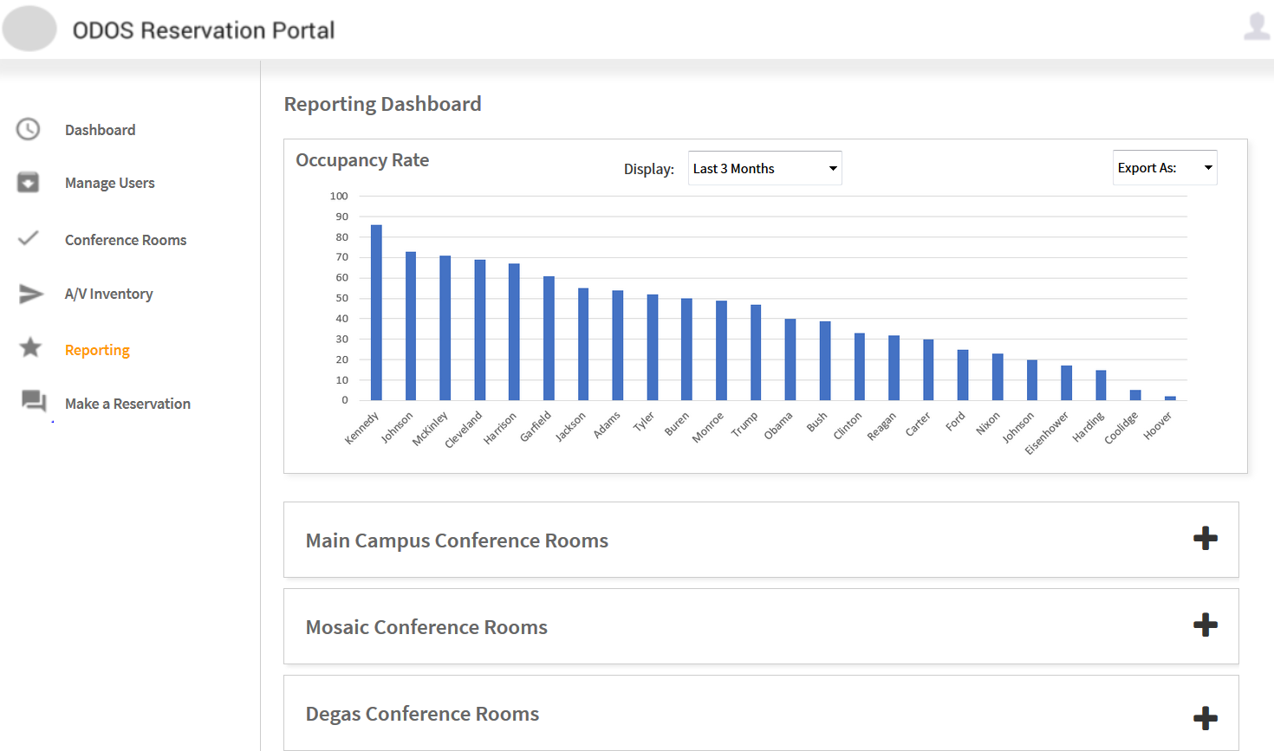
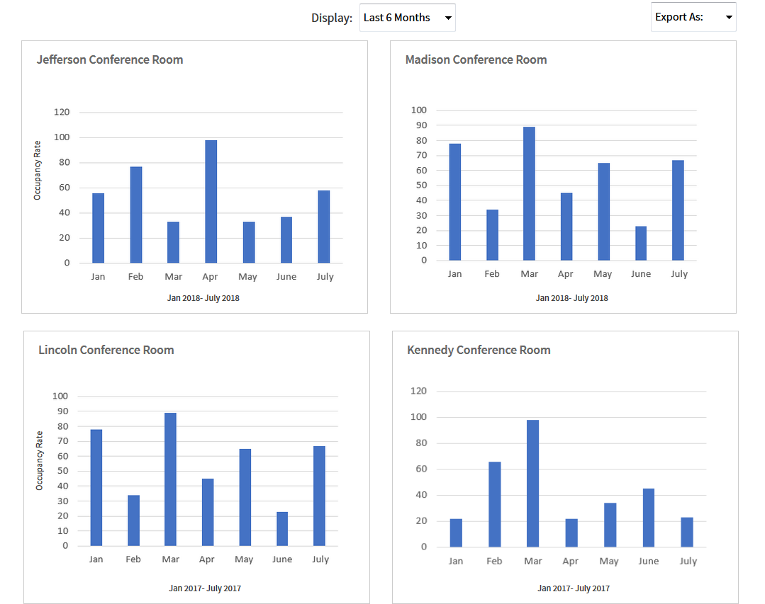
ODOS Reservation Portal: Persona > Reservation Manager
As a Reservation Manager, I shall be able to access a report for occupancy and vacancy rate of each conference room, which exportable with data depicted as a histogram.
As a Reservation Manager, I also can make a reservation, view user friendly messaging, and view the display panel as a Requester.
Reservation Manager
Login/Entry Screen
Report Dashboard
View/Export Reports
Make Reservation
Available Rooms Returned
Room Selected
Edit/Cancel Reservation
Oops! Try Again!
View Display Panel
User Friendly Messaging
https://61zfrn.axshare.com/#g=1&p=report_dashboard_-__summary

Slide 3
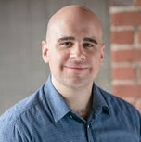
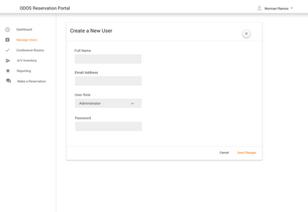
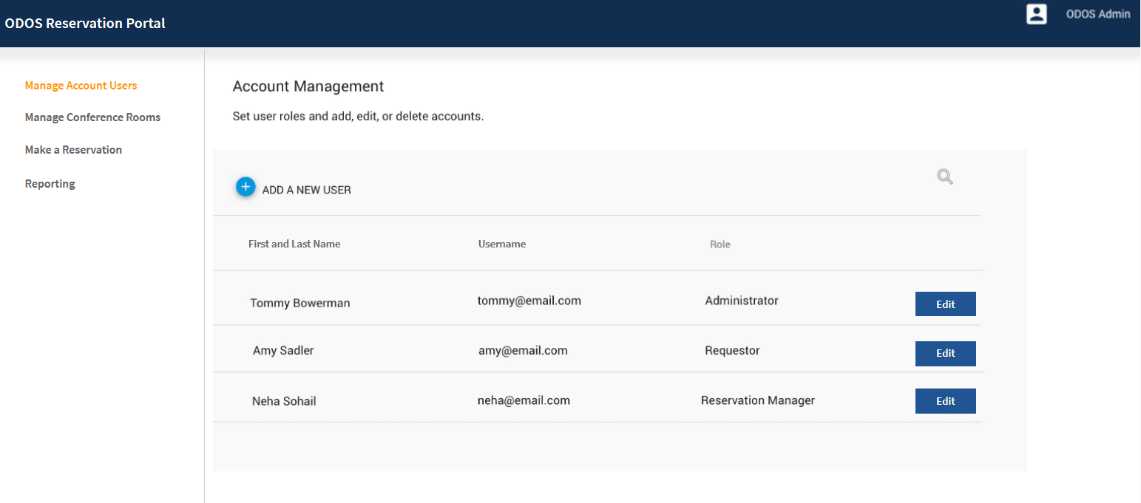
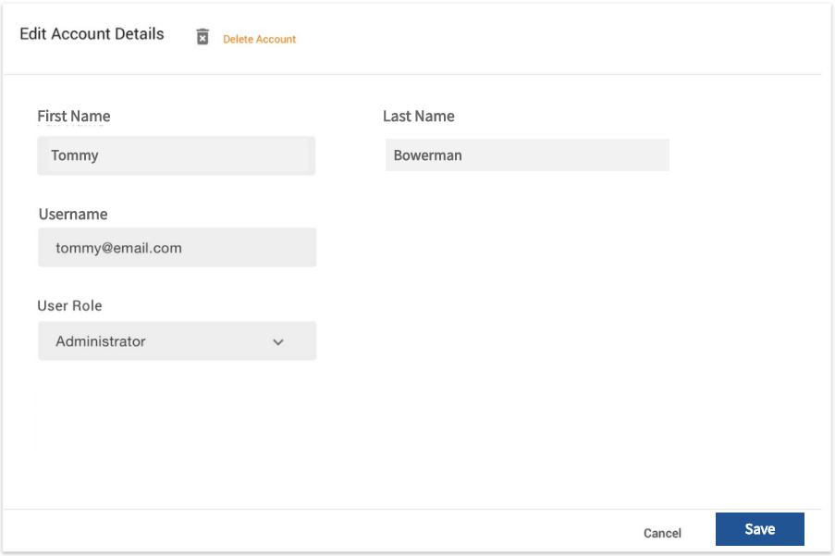
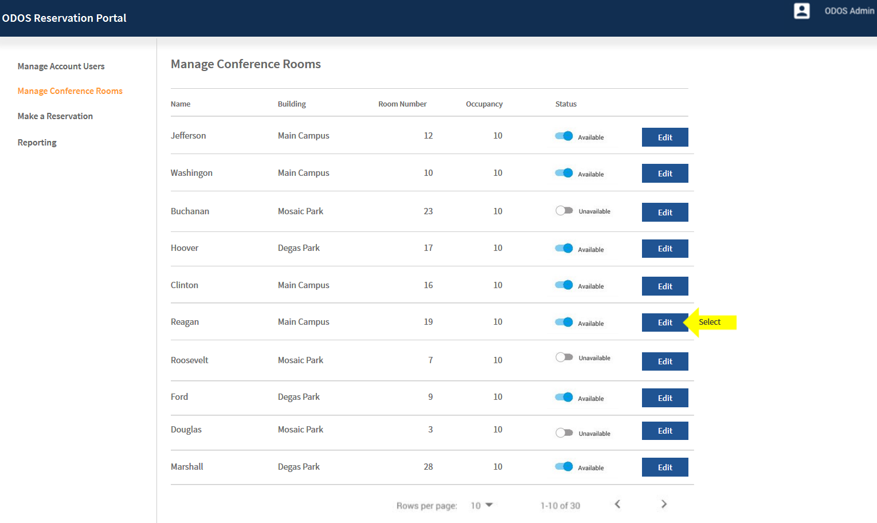
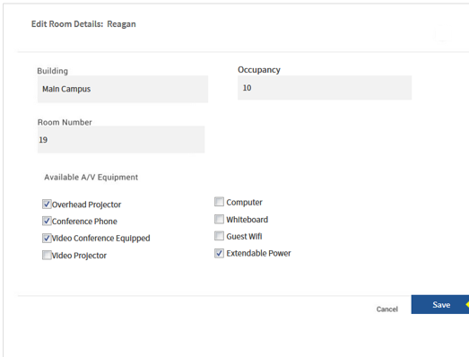
ODOS Reservation Portal: Persona > Administrator
As an Administrator, I shall be able to Add/Modify/Delete users, update available conference rooms, and change the Audio/Visual equipment list.
As a Administrator, I also have access to the features and functionality of a Reservation Manager, and a Requester.
Administrator
Login/Entry Screen
Create/Edit/Delete User
Manage Account Users
Oops! Try Again!
User Friendly Messaging
Edit Account Details
Manage Conference Rooms
View/Export Reports
Edit Room Details
View Display Panel

